Slide 1
Lecture 20 – Operand addressing
2017.10.06
People have no memory of phone numbers now because of the cell phone - their address book is in a cell phone.
– Gordon Bell
Led development of the VAX computer

Slide 2
Assignment for today
Finish reading chapter 7
Read chapter 8

Slide 3
Announcements
Lab sessions cancelled next week (Oct. 11-13)
Optional Lab 04B posted on Blackboard
Lab 04B is a register with LOAD, INVERT, and CLEAR
You may replace your existing Lab 04 score with a score for Lab 04B by submitting work for Lab 04B
Lab 04B is due the week of Oct. 16

Slide 4
Early computers
Hardware was strongly quantity limited because
Cost per gate was high
Reliability of gates was low
Circuits with more than, say, a few thousand gates would likely contain a faulty gate
Computers were unfamiliar, hence used by a small community
Thus
Circuitry to execute instructions and to store useful amounts of instructions and data kept to a minimum
Users could be trusted with the whole system and were willing to deal with its lack of built in support for many things

Slide 5
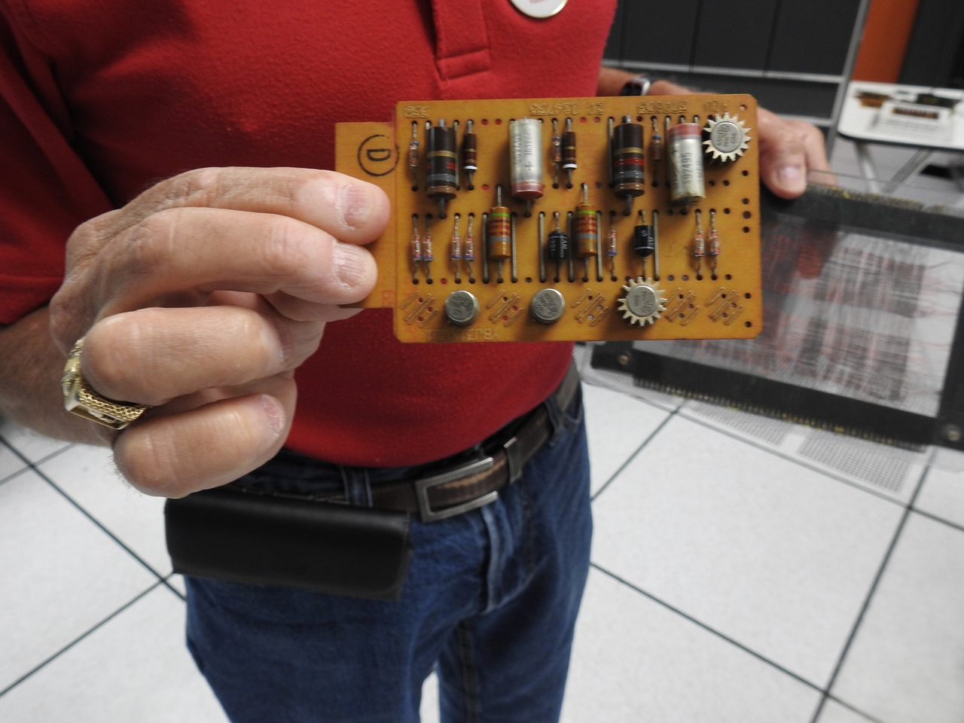
Example: IBM 1401 circuit card

Slide 6
Instruction operands: How few is possible?
Each operand requires bits for either its immediate value or a pointer to operand
Immediate values are fast, but not necessary, so consider only # of pointers
Number of pointers (# of addresses) used in the instructions of actual ISAs:
Zero, called a 0-address architecture
One, 1-address architecture
Two, 2-address architecture
Three, 3-address architecture

Slide 7
0-address architecture: Stack machine
Operand locations are always implied, except
PUSH and POP instrs. have explicit operands
PUSH and POP move operands between memory and a stack (of registers) within the processor
Instructions other than PUSH and POP take operand(s) from the stack, starting at the top, and place result on the new top of the stack
Example of a stack machine: a Reverse Polish Notation (RPN) calculator

Slide 8
Code for C=A+B for 0-addr. machine
Assumes A, B, C all belong in memory and that A, B not destroyed
Stack
Processor
Assembly instruction PUSH copies the contents of a memory location into Top of Stack register.
PUSH A uses the pointer A to point at a memory location, where the contents, also called A, are copied to the top of the stack.
Top of
Stack →
Stack
←Push A
A
…
ALU
…
Memory
A
B
…
Push A
Push B
Add
Pop C

Slide 9
Code for C=A+B for 0-addr. machine
Assumes A, B, C all belong in memory and that A, B not destroyed
Stack
Processor
PUSH B copies B to the top of the stack.
A stack is a hardwired set of registers connected to perform the function of the stack data structure.
When an item is to be loaded into the stack Top position, all registers in the stack shift (load) their contents into the next lower register in the stack, making room at the TOP for the new item.
The number of registers in the Stack is a design choice.
If a stack is full, PUSH could drive the contents of the lowest stack register into the bit bucket – bad news for the program – so stacks include the ability to spill into memory.
Top of
Stack →
Stack
←Push B
B
A
…
ALU
…
Memory
A
B
…
Push A
Push B
Add
Pop C

Slide 10
Code for C=A+B for 0-addr. machine
Assumes A, B, C all belong in memory and that A, B not destroyed
Stack
Processor
The ALU in a stack machine is hardwired to obtain two operands, one each from the Top of Stack register and the Next to Top register. Note the two arrows showing the paths from these registers to the ALU.
When the operation executes, the entire stack shifts its contents up one register level and the ALU output (operation result) is loaded into the Top register. Both operands in the stack are overwritten (bit bucket, again) as a side effect of execution, but copies remain in memory.
If the ALU operation is defined to use only one operand then the stack does not shift up and the result overwrites its own operand.
Top of
Stack →
Stack
C
…
B
A
Add
ALU
C
…
Memory
A
B
…
Push A
Push B
Add
Pop C

Slide 11
Code for C=A+B for 0-addr. machine
Assumes A, B, C all belong in memory and that A, B not destroyed
Stack
Processor
Stack
Assembly instruction POP copies the contents of the Top of Stack register into a designated memory location AND causes the registers in the stack to all shift up a level, overwriting the current Top contents.
POP C uses the pointer C to point at a memory location and write into it the contents of Top of Stack, also called C.
Top of
Stack →
…
ALU
…
Memory
A
B
C
…
Push A
Push B
Add
Pop C
←Pop C

Slide 12
1-address: Accumulator machine
One special register, called the accumulator
One operand for most instructions is the accumulator, one operand from a memory address
Result always sent to the accumulator; previous accumulator contents sent to the bit bucket
Example: cheap calculator

Slide 13
2-address machine
Not a stand-alone processor design
Rather, a design for an embedded memory copying circuit

Slide 14
3-address machine: current processors
Gain ability to specify location to store result
Avoid side effect of overwriting an operand
Machine code sequences to implement high-level language programs are more compact and faster
Register file is a design choice with the purpose of avoiding some use of slow main memory circuits

Slide 15
Code for C=A+B for 0-, 1-, and 3-addr.
Assumes A, B, C all belong in memory and that A, B not destroyed
Stack
Accumulator
Reg-Mem
Reg-Reg/
Load-store
Processor
…
…
Reg file
Reg file
Top of
Stack →
Stack
Accum-ulator
…
…
…
ALU
ALU
ALU
ALU
…
…
…
…
Memory
A
A
A
A
B
B
B
B
C
C
C
C
…
…
…
…
Push A
Push B
Add
Pop C
Load A
Add B
Store C
Load R1,A
Add R4,R1,B
Store C,R4
Load R1,A
Load R2,B
Add R4,R2,R1
Store C,R4

Slide 16
ISAs with dedicated instr. for mem access
0-address and Reg-Reg, a.k.a Load/Store, architectures have instructions specifically to read/write computer memory
3-address
Reg-Mem
Architecture
0-address
Stack architecture
1-address
Accumulator
3-address
Reg-Reg/
Load-store Arch.
Processor
…
…
Reg file
Reg file
Stack
←Load
Top of
Stack→
←Push
Accum-ulator
…
…
…
ALU
ALU
ALU
ALU
…
…
…
…
Memory
←Pop
←Store
…
…
…
…

Slide 17
Sources of operands
Immediate operand – the field in the instruction bit string contains the actual bit string of the operand (the operand value)
Called “immediate” because there is immediate access to the operand value for execution
Register – pointed to by an instruction field
Memory – a memory address is, typically, too many bits to fit within a field within an instr.
Pointer to in-memory operand will be computed
Memory is slow these days, so we source operands from memory only when we must

Slide 18
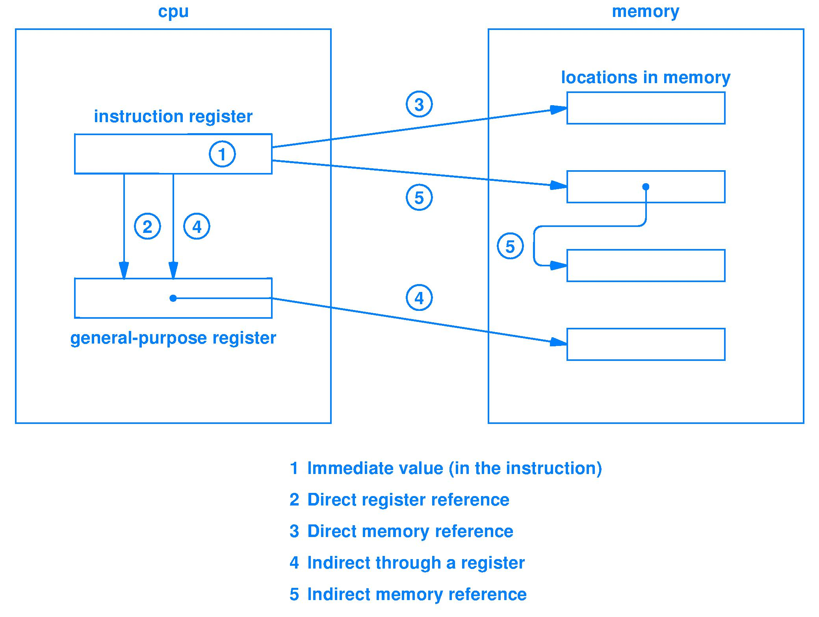
Example operand addressing modes (Fig. 7.6)
Notes:
Thought question

Slide 19
Von Neumann bottleneck
Today, main memory technology (DRAM) is very slow compared to speed of a processor
Processors consume operands and produce results far faster than current main memory technology can readily source and sink them
Time spent accessing memory often dominates the total time to run a program
Architects use the term von Neumann Bottleneck to describe the situation when memory access time (processor waiting) is the majority of the run time

Slide 20
Design tradeoffs for operands
Different operand sources and forms have different
Ease of programming/compiling
Fewer/more machine instructions
Smaller/larger machine instructions
Larger/smaller range of immediate values
Faster/slower operand fetch
Larger/smaller processor circuit size
There is not one right answer

Slide 21
Summary
Operand types and addressing are design choices
Immediate operands are constants contained within the instruction
Pointers to registers (smaller) and memory (often too large) are used in instructions
Can obtain operands via indirection
Register contains an address to memory
A memory location contains an address to memory

Slide 22
Lecture 21 – Modes and Microcode
2017.10.06
It’s a small world after all.
– Walt Disney

Slide 23
Assignment for today
Finish reading chapter 8
Read chapter 10 and 11 about memory

Slide 24
Anouncements
This slide intentionally left almost blank

Slide 25
Execution modes
CPU hardware has several possible modes
At any time, CPU operates in one mode
Mode sets various parameters, including, but not limited to
Privilege level
Which instructions of the ISA are valid
Which addresses are valid
Size of data items
Backward compatibility with earlier ISAs

Slide 26
How to think about modes
Imagine different CPUs inside a given CPU
Mode selects which CPU is currently in use
Two modes may have different
Numbers of registers
Register size
Instruction sets

Slide 27
How to change between modes
Automatic change (hardware does its thing)
Initiated by hardware: example, an Input/Output (I/O) device needs service
Prior to changing mode, operating system (OS) specifies the new mode
“Manual” change (under program control)
Initiated by software, typically the OS
Typical example, application program calls an OS function
Some modes can be selected by an application

Slide 28
Privilege and protection
Number of privilege levels is a design choice: from 0 levels up to 8 levels have been built
Levels limit operations allowed so CPU can detect “unauthorized operations”
Example, I/O device service (printing)
CPU must allow device driver software in the OS to interact with the I/O device
Applications must not be allowed to do this
Erroneous or malicious commands to I/O devices are often dangerous
Notes:
Halt and Catch Fire story here

Slide 29
Microcoded instructions
How should a CPU be implemented?
One way is totally in hardware, another is to combine a simpler circuit and stored code
Microprocessor (simple, perhaps narrow circuit) provides basic instructions
Stored code implements “macro” instructions built out of basic instructions and offers additional, more sophisticated capabilities
Key idea: can add complex instructions (macro) more easily via code than via circuitry
Change stored code to allow field upgrades

Slide 30
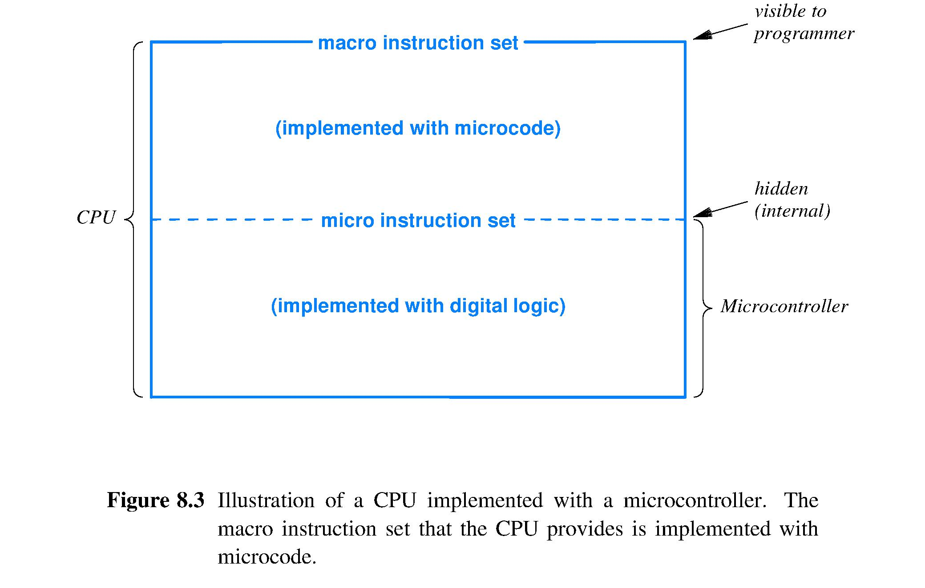
CPU with microcode

Slide 31
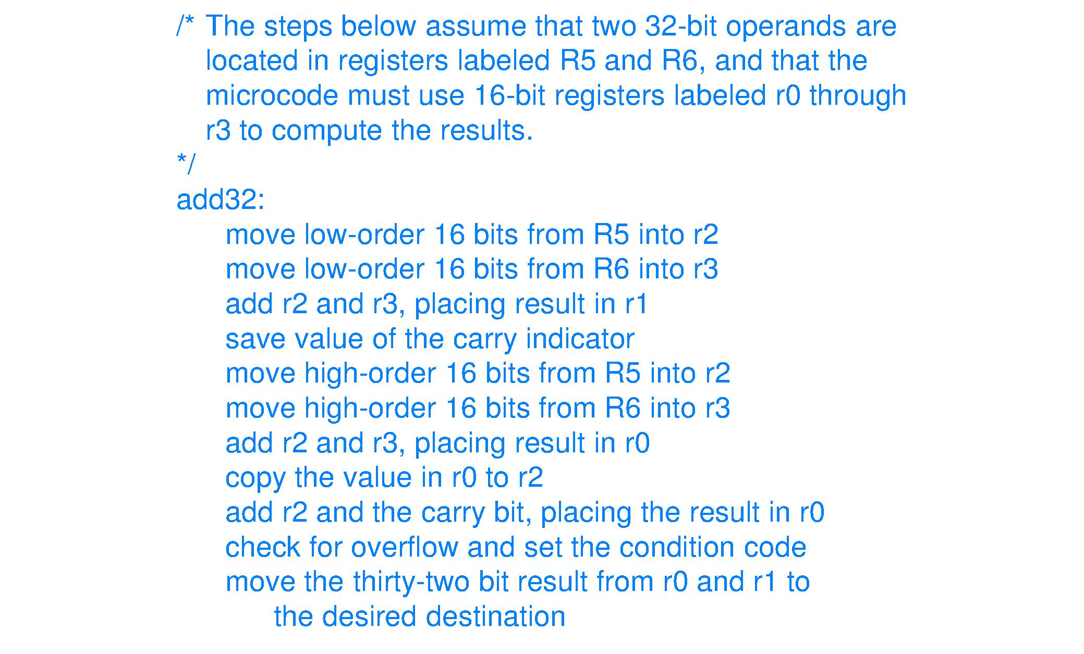
32-bit ADD32 macro for 16-bit circuit
Figure 8.4
01
02
03
04
05
06
07
08
09
10
11

Slide 32
Microcode pro and con
Pro
Fast update (revision) of a processor
Circuit errors possibly can be “papered over” by adding microcode to compensate for a flaw
Microcode usually hidden from programmers
Con
Execution time: macro instructions take the time of multiple machine instrs. (microcode instr.)
Microcode usually hidden from programmers; when not hidden, CPU is called “reconfigurable”

Slide 33
Vertical or horizontal microcode
Vertical microcode uses a full-featured, but simpler and/or narrower microcontroller and then builds macro instrs. on this foundation
Example, x86 uses a RISC microcontroller inside and vertical microcode to implement CISC instructions of x86 ISA
One macro instruction usually requires several to many micro-instructions
Horizontal microcode, in contrast, specifies control signals for processor function units: no decode for horizontal micro-instructions

Slide 34
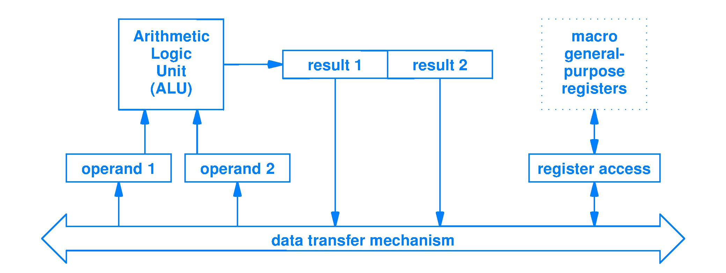
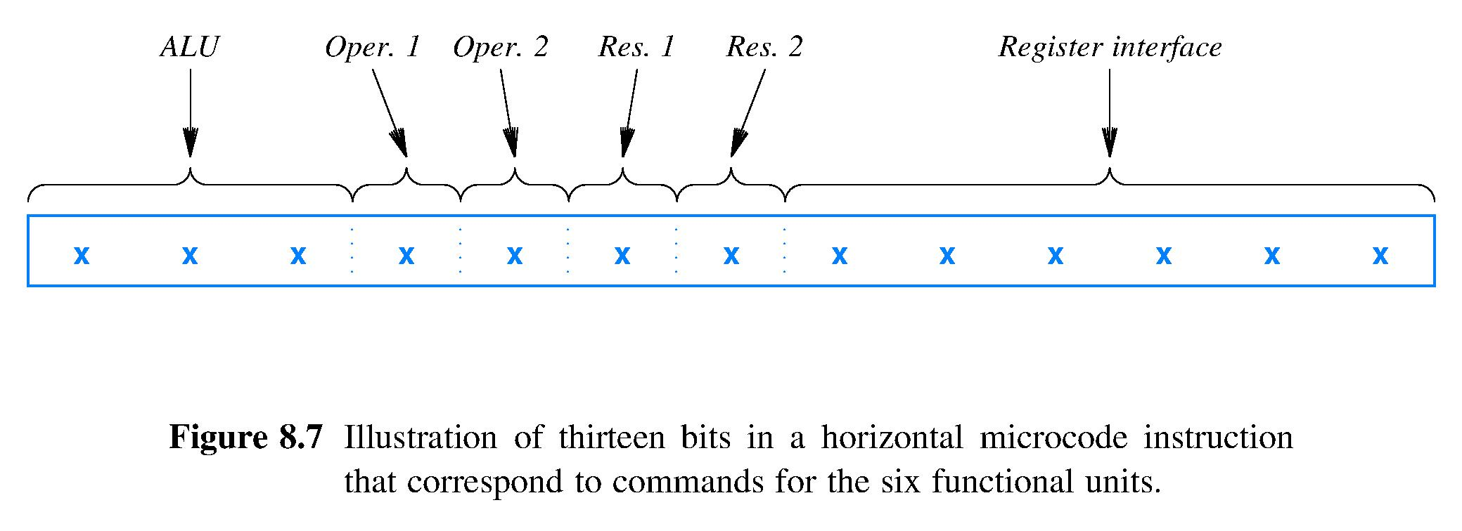
Horizontal microcode format
Horizontal microcode is programming the control signals for a processor, Figure 8.5, for example
One data path shared by all units, rather than dedicated paths as seen in Fig. 6.9

Slide 35
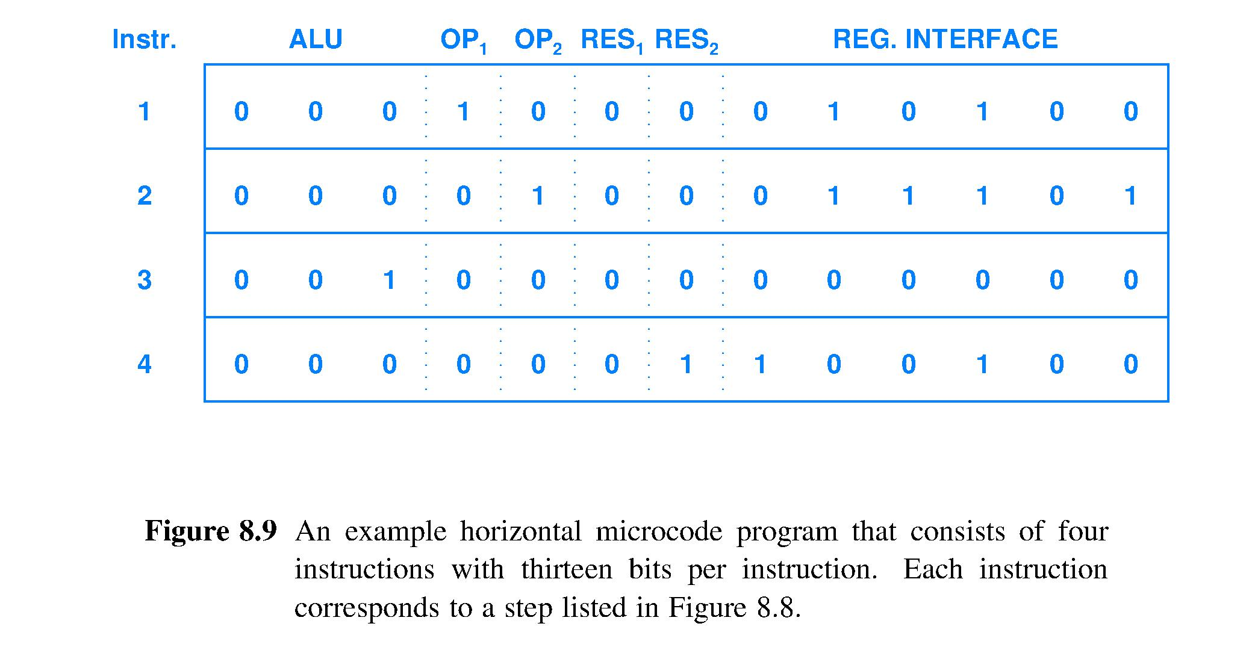
Implementing horizontal microcode
Fig 8.9: code to add
Each machine language instruction will have a microcode sequence similar to the above
Executing a machine language instruction is like calling a subroutine
Each horizontal microcode sequence needs HALT or RETURN; may also need conditional execution and iteration capability; above figure does not show this

Slide 36
Horizontal microcode characteristics
Easy to specify simultaneous, Parallel, operation of processor hardware units
Example: an ALU operation that takes more than one clock cycle to complete
Operands finish coming from fast register unit during the first clock cycle
Register unit could then sit idle, or instead, could perhaps service other operations while multi-cycle ALU operation continues to execute
More work in progress simultaneously means overall work of a program may complete sooner

Slide 37
Summary
CPU modes determine protection and privilege
CISC ISA usually implemented with vertical microcode; RISC ISA usually no microcode
Vertical microcode uses a conventional- looking code (like assembly for a simpler CPU)
Horizontal microcode looks like complex Boolean logic functions
Horizontal microcode, when used, is for the purpose of achieving more simultaneous circuit actions to advance program progress

